Slide 1
Akrivia Health / Global Minds Proteomics Update
2026-Feb-17

Slide 2
Agenda

Slide 3
Agenda
Action Item Review
Team Updates – Data Normalization & QC
Open Q&A, Discussion, and Timelines

Slide 4
Meeting Minutes & Action Items

Slide 5
Minutes from 14-Feb-2026 Meeting
Action Item Review
Joe: Confirmed that the 17 samples identified in the previous meeting are still being investigated by Akrivia, but the analysis can proceed and the normalization metadata has been provided to Julie via email.
Joe: Asekd about the clinical data format needs. Julie: Requesting raw clinical data that can be used as an overlap with existing proteomics data, along with any specific instructions about patient exclusions or phenotype focus.
Updates
Julie: Proposed also merging schizoaffective disorder and schizophrenia classes into one schizophrenia disorder class to maintain consistency with other disorder classifications, which Joe approved.
Julie: Reviewed the quality control analysis of the Somascan dataset that revealed a normal distribution with good gaussian characteristics after calibration and normalizations.
Julie: PCA analysis showed no technical biases from box identifier, plate ID, or scanner ID.
Julie: Biological variables including merged diagnoses (bipolar disorder, dementia, schizophrenia, and depression), sex, and age groups (18-30, 30-45, 45-60, 60-80, 80+) did not show strong separation patterns in the PCA plots.
Julie: Age distribution analysis confirmed expected patterns with dementia overrepresented in older age groups (60-80), particularly visible in the bottom right quadrant of the PCA plot.
Farzad: Asked about implementing quantitative metrics instead of visual assessment to statistically validate the absence of bias effects, especially when dealing with multiple age groups. Julie: Shared that the differential abundance analysis (DAA) will provide the statistical validation, including significance testing between age groups, sex, and diagnosis categories. But she would look into additional methods.

Slide 6
Minutes from 14-Feb-2026 Meeting
Updates (cont.)
Joe/Farzad/Julie: Discussed and confirmed that dataset quality was clean with no obvious bias, though control samples are missing as previously known from the project start.
Julie: The differential abundance analysis (DAA) has already been started and will be the focus of next week's update.
Corey: Did a high level review of the timeline and analysis next steps.

Slide 7
Action Items
Action Items from 17-Feb-2026 Meeting
Julie: Julie to consider further analysis during the DAA that can statistically validate the absence of bias effects - IN PROGRESS
Action Items from 10-Feb-2026-Feb Meeting
Joe: Joe to reach out to Akrivia to get clarification about the 17 samples labeled as 'other' - IN PROGRESS
Joe: Provide Julie with any details about the normalization process that was applied to one of the data files - IN PROGRESS
Joe: Check on the progress of clinical data analysis and share any relevant co-morbidities or self-reported information that might be useful for differential analysis in next week's meeting – IN PROGRESS
Julie: Start on the QC and normalization process – COMPLETED, 13-Feb-2026

Slide 8
Updates & QC of SomaScan dataset

Slide 9
Dataset review
Diagnosis | Number of samples
Bipolar + Mania/Hypomania (bipolar disorders) | 80 + 1
Psychosis + Brief psychotic disorder (psychotic disorders) | 35 + 1
Depression + Postnatal depression (depressive disorders) | 149 + 3
Dementia | 125
Schizoaffective disorder + Schizophrenia (schizophrenic disorders) | 10 + 44
Changed compared
to last week
Suggested solution for small classes: merging related diagnosis classes to have at least
10 samples per class.

Slide 10
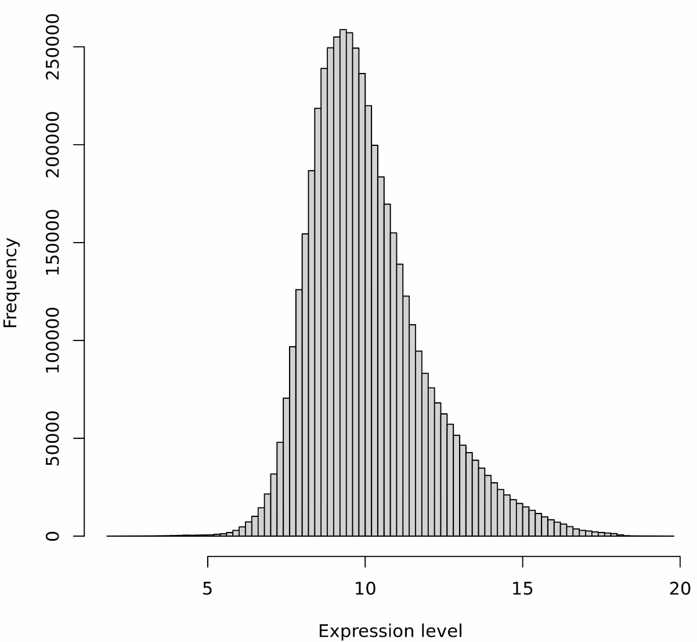
QC of all samples after class merging
Normal distribution of expression level on histogram after calibration normalization, hybridization normalization, intra-plate scale normalization and plate scaling (already performed on dataset)

Slide 11
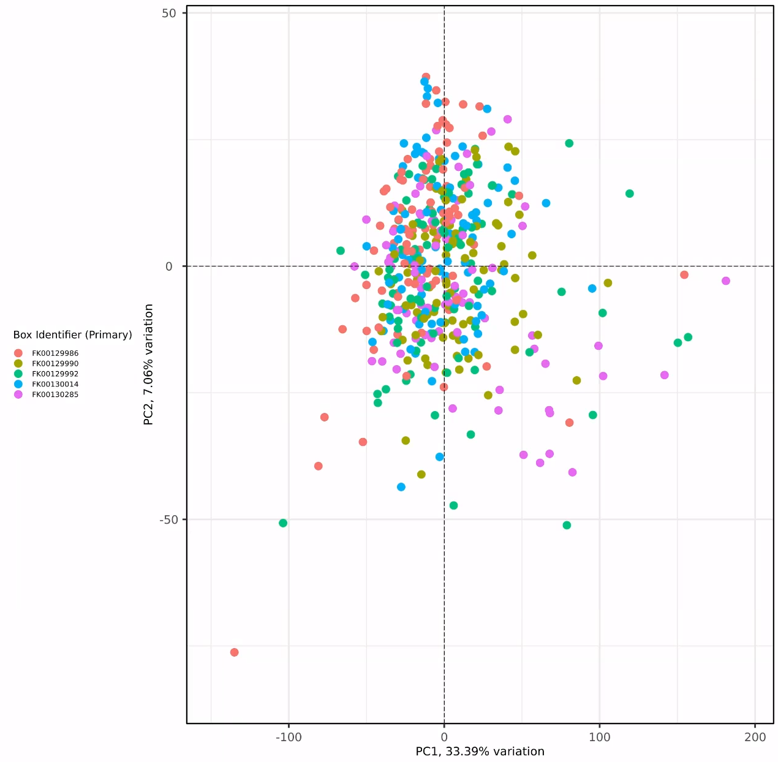
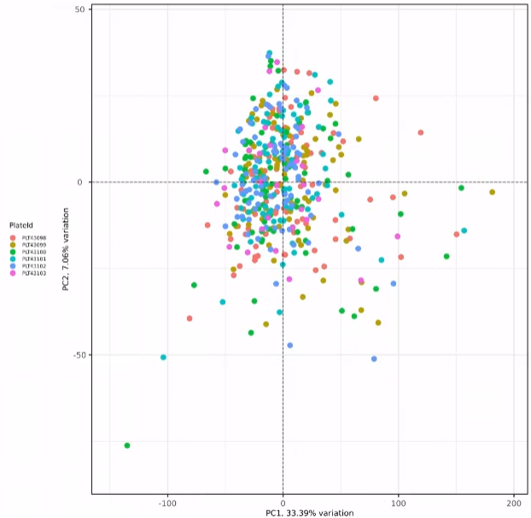
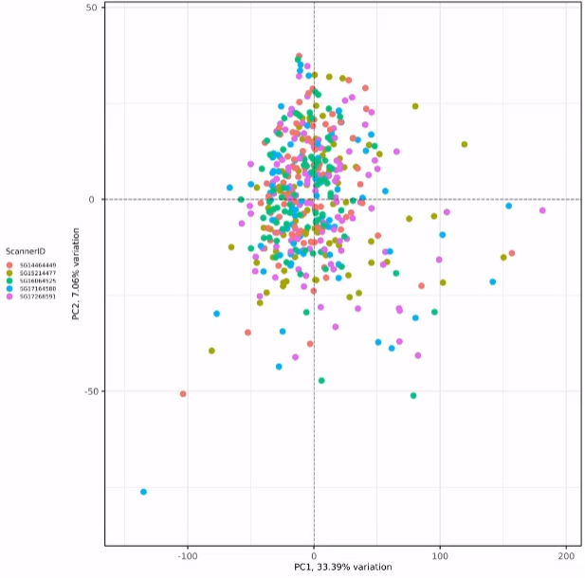
QC of all samples after class merging
Normal distribution of expression level on histogram
No obvious box-induced bias
No obvious PlateId-induced bias
No obvious ScannerID-induced bias

Slide 12
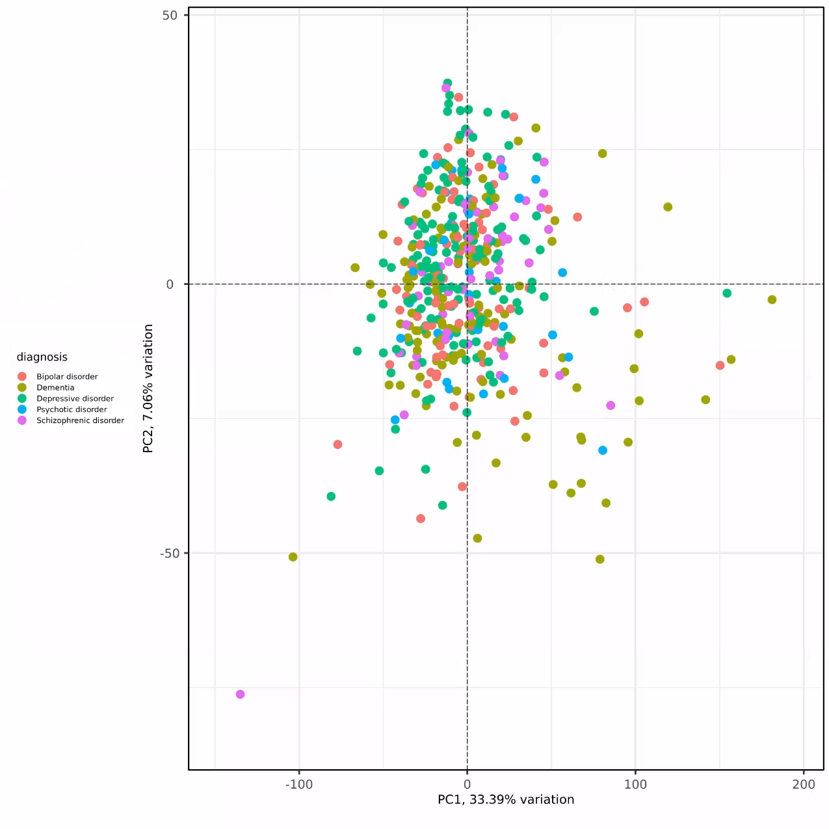
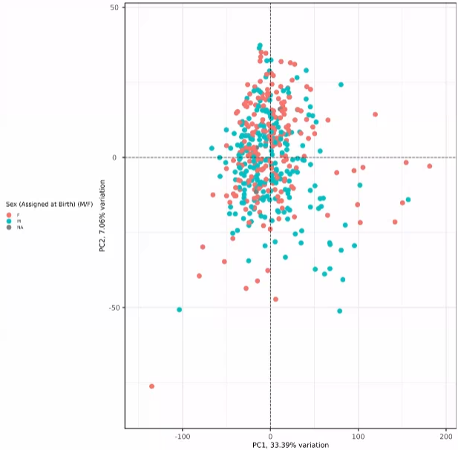
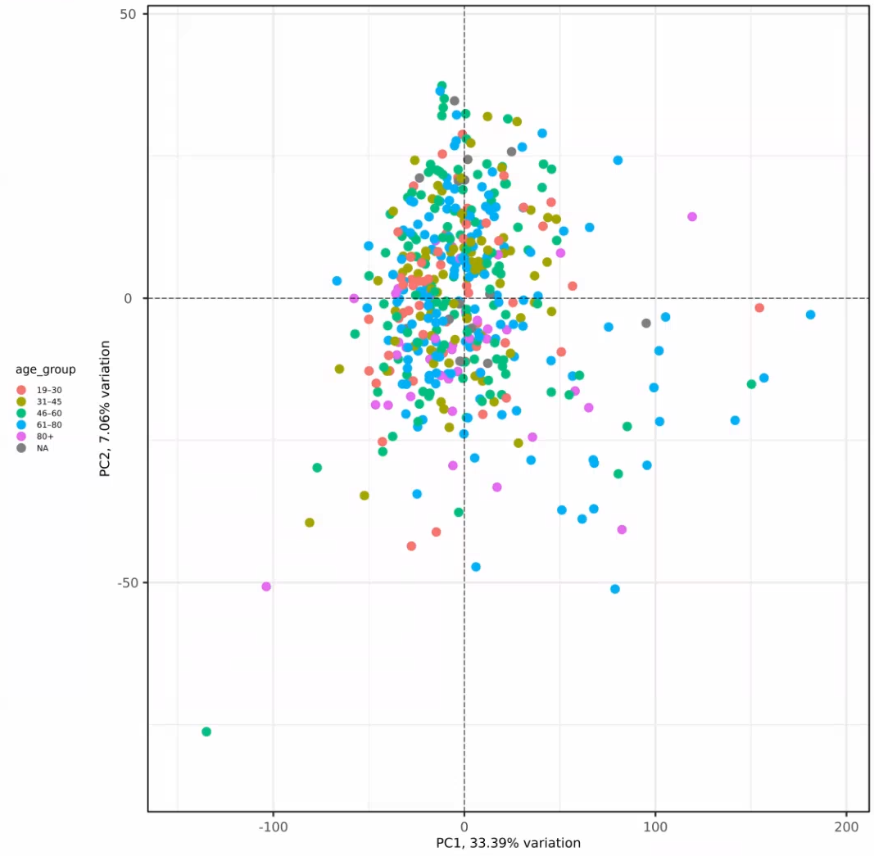
QC of all samples after class merging
No obvious diagnosis-specific grouping of samples
No obvious sex-specific grouping of samples
No obvious age-specific grouping of samples

Slide 13
J&J: Akrivia Health SomaLogic Proteomics Analysis Timeline
Today
2026
Feb
Mar
Feb 3 - Feb 9
5 days
Onboarding, Environment Setup, Data Import into Domino
Feb 10 - Feb 13
4 days
Data Normalization & QC
2026
Global Minds / Akrivia Proteomics Analysis
Feb 16 - Feb 23
6 days
Diff Abundance Analysis (DAA)
Feb 24 - Mar 3
6 days
Pathway Analysis
Mar 4 - Mar 9
4 days
Compare Treatment-Resistant Patients vs Responders
Mar 10 - Mar 12
3 days
Correlate Proteomics Levels to Clinical Data
Mar 13 - Mar 16
2 days
Reporting & QC
Timeline
On-Boarding (4 hours)
Data Retrieval, Normalization, & QC (16 hours)
Differential Abundance Analysis (DAA) (24 hours)
Pathway Analysis (24 hours)
Compare treatment-resistant patients vs responders (16 hours)
Correlate proteomics levels to clinical data (12 hours)
Reporting & QC (8 hours)
Total: 104 hours Bioinformatics; 10 hours Project Management.

Slide 14
Archive

Slide 15
Action Items
Action Items from 2026-Feb-03 Meeting
Joe: Provide access to the MS Teams folder with the clinical XLS files – COMPLETED, 2026-Feb-06
Farzad: Create a new Domino project and upload the proteomics data files for the analysis – COMPLETED, 2026-Feb-03
Corey: Setup weekly calendar cadence for the team to meet – COMPLETE, 2026-Feb-03

